Slide 1


1
Working with large data in Excel
Presented by: Data Team

Slide 2
Working with large dataset
Excel has a lot of things to offer especially when working with large dataset.
Moving from one cell to another using ctrl+ arrow keys
Freeze pane
Raw data to Excel Table
Sorting
Filter by conditions (color, regex, etc)

Slide 3
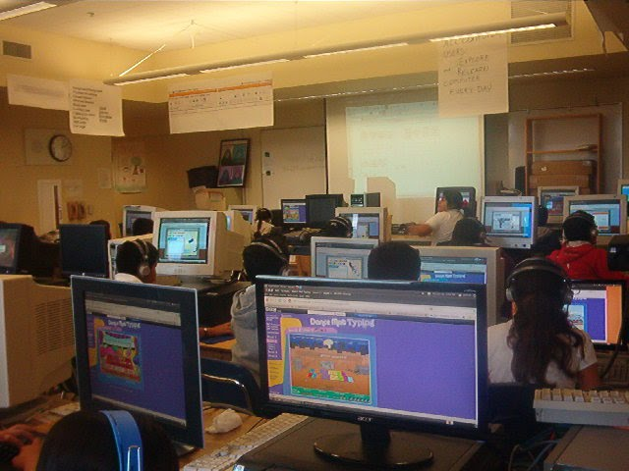
Lab session

Slide 4


Thank You

